Slide 1

Project 3: Web APIs and NLP
r/improv vs r/StandUpComedy

Slide 2
Agenda
Introduction/Problem Statement
Model used and scoring metrics
Web scraping and data cleaning
Pre-processing
EDA and Visualization
Modeling
Conclusions / Limitations
Recommendations

Slide 3
Introduction
Improv vs Stand Up Comedy, 2 forms of artistic expression that are commonly and erroneously used interchangeably.
"Three key differences between the two to underline:
Stand-ups are alone on stage, whereas improv folks are onstage with 2-3 other teammates.
Stand-ups craft repeatable messaging designed to sell our audiences on ideas & things we find funny. Improv teams are creating stories on the spot, which forever disappear the moment they're completed – all to never be recreated again.
Improv folks are positive.”
~ Jon Selig
Source: https://www.linkedin.com/pulse/necessary-distinction-jon-selig/

Slide 4
Problem Statement
A performing arts center is thinking of adding courses to their roster for revenue and is looking to compile feedback on Improv and StandUpComedy.
1. The performing arts center would like to be able to separate comments from each subreddit for easy reference.
2. They would like to see the terms that are commonly associated with each performing art in order to better formulate their syllabus.
3. As a secondary concern, they would also like to see which art form may respond better to classes and structured instruction.

Slide 5
Models
Multinomial Naive Bayes and Logistic Regression
Logistic regression is easier to implement, interpret, and very efficient to train.
Naive Bayes doesn't require as much training data. It handles both continuous and discrete data. It is highly scalable with the number of predictors and data points. It is fast and can be used to make real-time predictions.

Slide 6
Scoring metrics
Accuracy
improv and StandUpComedy observations are pretty much even
objective is just to correctly and accurately classify the posts to garner more information
As opposed to
- Sensitivity
- Specificity
- Precision

Slide 7
Web Scraping and data cleaning
Using Pushshift's API
Subreddits: r/improv and r/StandUpComedy
2000 of the latest posts scraped from each subreddit for a total of 4000 posts
After removing duplicates and dealing with null values, remaining 3920 observations.
Used a combination of tools to remove unwanted text and symbols from data.

Slide 8
Preprocessing
Tokenize text
Remove stopwords
Stemming
Lemmatizing
Used ‘English’ stopwords and created custom list of stopwords.
Proceeded with the next steps using the lemmatized text.
Stemming caused words to become nonsensical.

Slide 9
EDA and Visualization
Plot bar charts using
1. CVEC (Count Vectorization)
2. TF-IDF (Term Frequency-Inverse Document Frequency)
Plot for unigram, bigram and trigram.

Slide 10
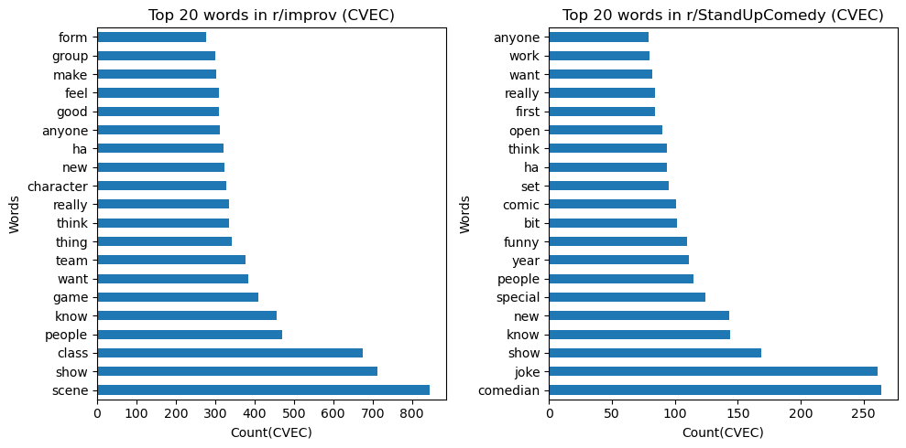
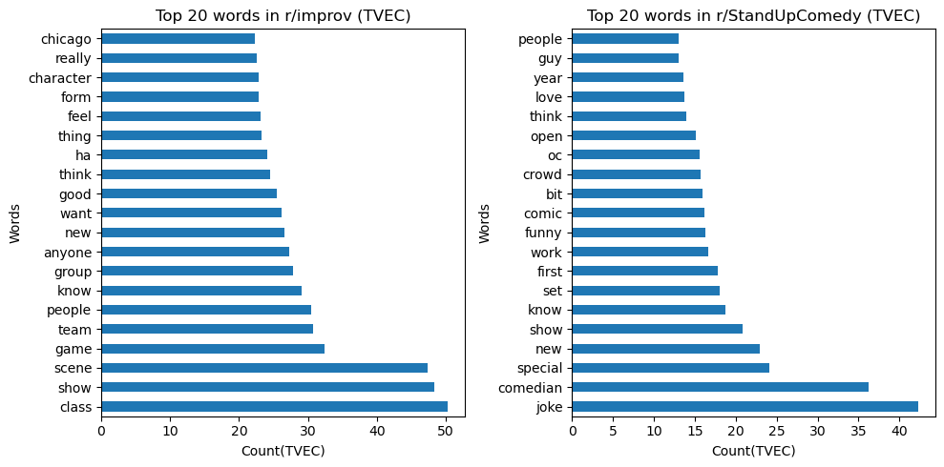
Unigram

Slide 11
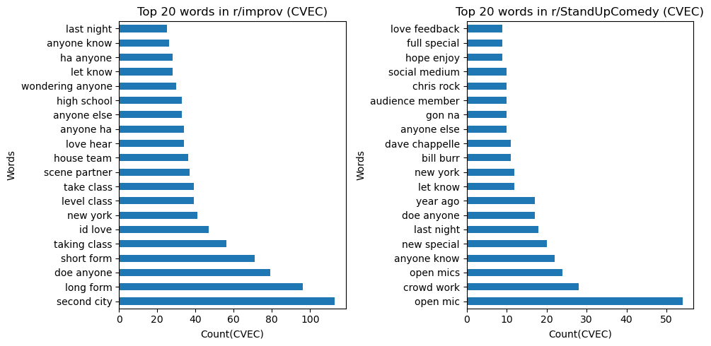
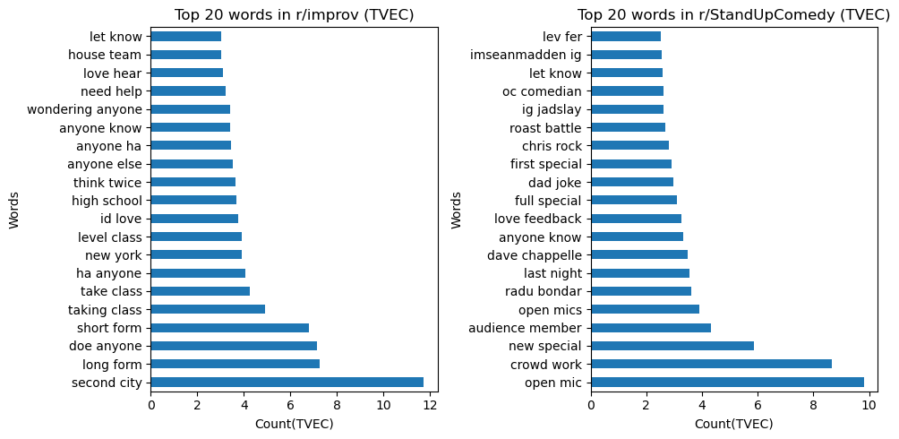
Bigram

Slide 12
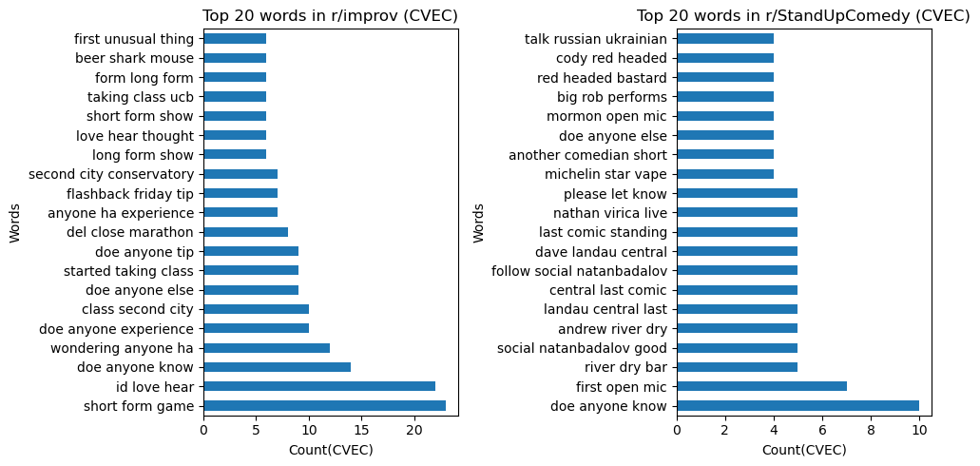
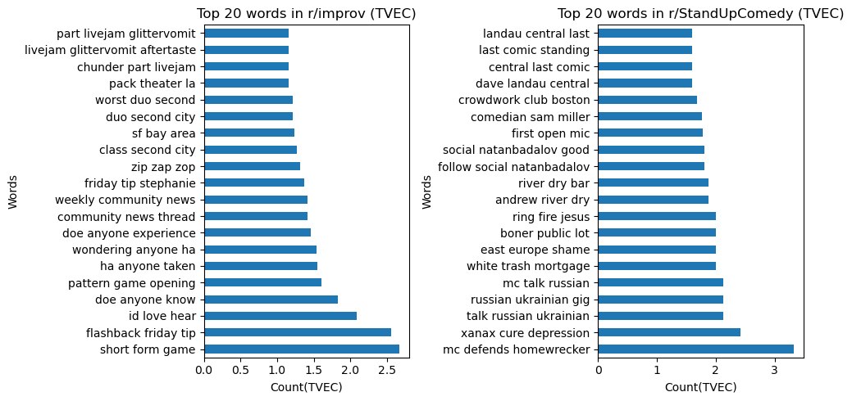
Trigram

Slide 13
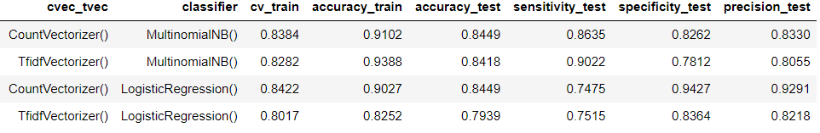
Modeling
Baseline taken using value counts of each subreddit
Improv 50.1%
StandUpComedy 49.9%

Slide 14
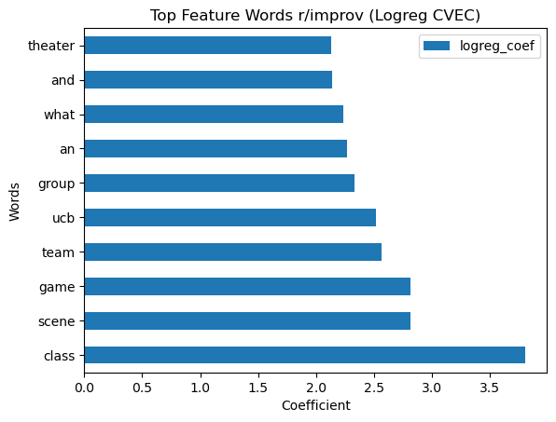
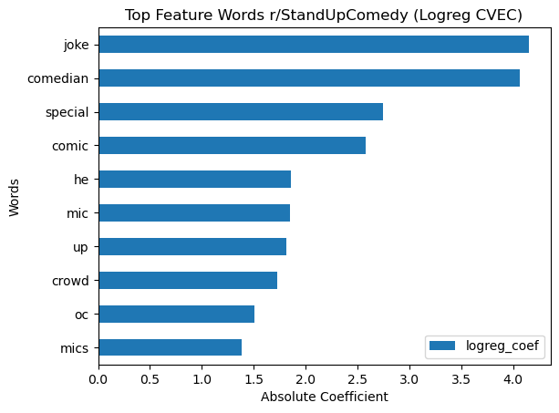
Modeling cont’d
Best models and best params:
CVEC LogisticRegression() Best Params: {'cvec__max_features': 10000, 'cvec__ngram_range': (1, 3), 'logreg__C': 0.1, 'logreg__penalty': 'l2', 'logreg__solver': 'liblinear'}
Interpreting coefficients

Slide 15


Modeling cont’d
Best models and best params:
TVEC LogisticRegression() Best Params: {'logreg__C': 0.1, 'logreg__penalty': 'l2', 'logreg__solver': 'liblinear', 'tvec__max_features': 15000, 'tvec__ngram_range': (1, 3)}
Interpreting coefficients

Slide 16
Conclusion
Although not in the top predictors for either subreddit, improv has a generally more positive tone to their posts, while StandUpComedy was a bit more cynical.
StandUpComedy: is mainly a solo performance which involves using humour and comedy as it's main entertainment medium. Some of the words associated with it indicate that it is a more popular in mainstream media, with words like mic, special(as in Netflix special or some other network special or comedy special) would indicate.
improv: is mainly a group activity and is commonly associated with scenes, long and short forms, and classes, and can be associated with not just comedy, but also any other form of artistic expression. It is also generally very positively portrayed as a team and group effort.
The words with the strongest coefficients make more sense for the LogisticRegression model with CountVectorizer.
All models had very similar run times that were relatively fast.

Slide 17
Limitations/Next steps
Time constraints, I was not able to explore Decision Tree and Random Forest models.
Introducing sentiment analysis to the reddit posts to further gauge the prevailing attitudes towards both forms performing arts.

Slide 18
Recommendations
Use the Logistic Regression model with CountVectorizer
Improv: Is more likely to be a class that people will sign up for. It is not generally associated with mainstream media. Can be sold both to individuals or as a group package. As a class, it would be easier to have a high student to teacher ratio as it can be taught in groups.
Stand Up Comedy: Is more likely to be for solo performers. There is likely to be a people taking courses out of interest, but it is also likely that people who want to make it a profession. Because it is a solo activity, the student to teacher ratio would most likely have to be smaller. Words like "special", "comedian" and "crowd" also references stand up comedy in popular culture. It could be worth cashing in on the popularity.

Slide 19
Recommendations
Pricing can also be higher for the Stand Up Comedy class because of the resources required in a lower student to teacher ratio, and also because it is more likely that people would be willing to pay a bit more for classes in something that could eventually be a career.
Class syllabus for improv could be structured more towards building synergy and responding to other people in a group/team.
Class syllabus for Stand Up Comedy could focus more on cultivating the individual's sense of humour and developing the ability of individuals to properly tell their jokes from the setup, to the body and finally the punchline.
If your performing arts centre is concerned about maintaining a clean image, you might want to steer clear of Stand Up Comedy and focus instead on just doing improv. However, if you are of the opinion that all attention is good attention no matter how controversial, then definitely add in Stand Up Comedy classes.

Slide 20
Questions?

